Slide 1
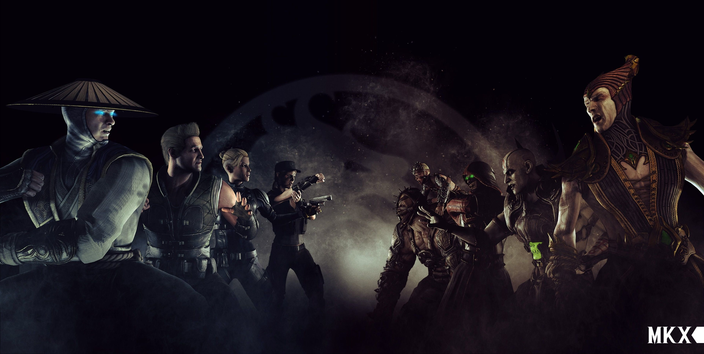

Mortal Kombat Mobile Everything you need to know
Preslav Yanchev 8g ITPG-Varna

Slide 2
Site theme
The site’s theme is Mortal Kombat Mobile and the most important things about the game like game modes, what to do to progress faster and overall information about the game.

Slide 3
For who’s the site intended
The site’s intended for everyone who plays or wants to play the game, because it has information for all type of players.

Slide 4
Main problems in making the site
The main problem in the site’s making was the design, because I had to edit the navigation bar multiple times, change whole pages and even start over the whole site.

Slide 5
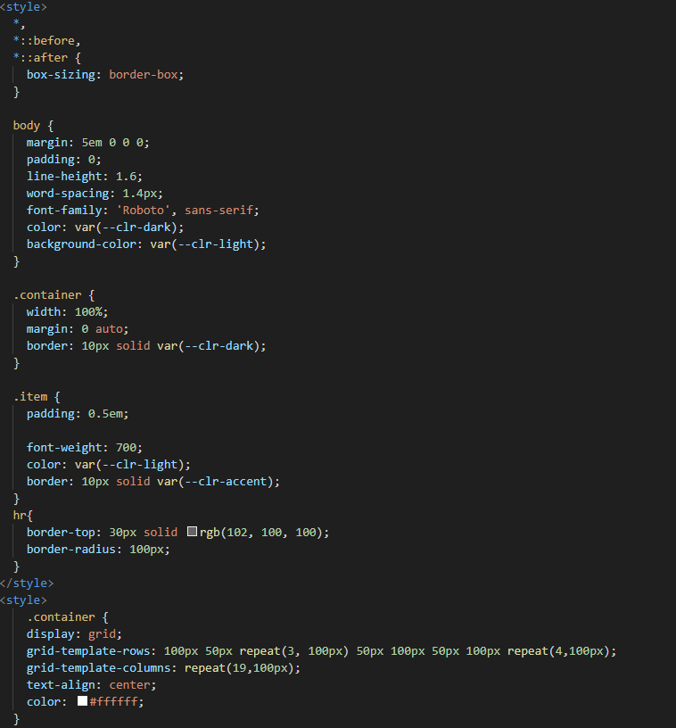
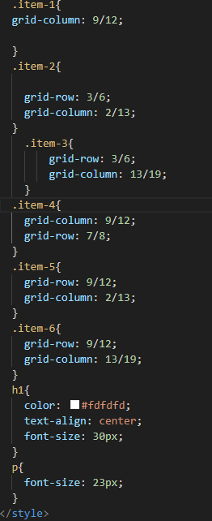
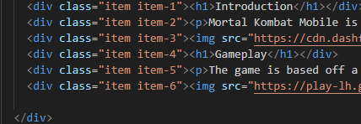
Codes I’m most proud with
The codes I’m most proud with are the grid codes because literally everything in the site is positioned with grid and had to learn how it works and how to use it.

Slide 6


